Slide 1
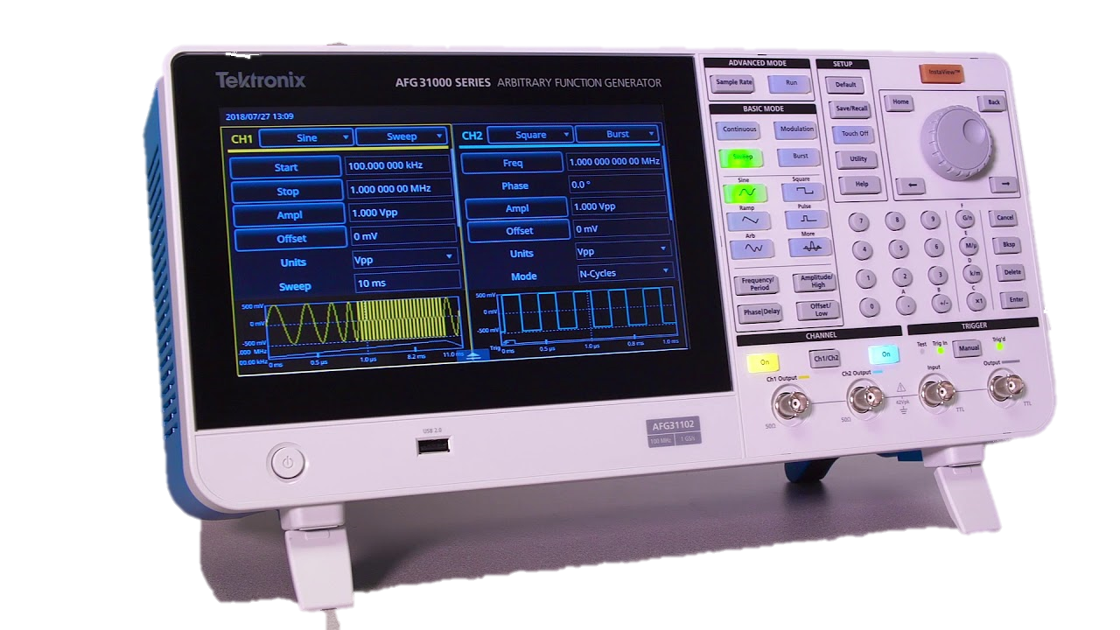
Function Generator
Group 20
AQEEL T.M.
KAUSHALYA P.A.S
LOKUGAMA V.Y.N
PATHIRANA T.P.W.
180039C
180320F
180359G
180453N

Slide 2
Introduction
The function generator
Can generate square, triangle ,sawtooth, PWM and sine waveforms.
Can change waveform frequency among a wide range of values.
Can change their amplitudes and average DC values.
Can be used in sweep generation, AM/FM generation, Phase Locked Loops(PLLs)

Slide 3
Design Specifications
Function generator should be able generate sine, square, pulse width modulation, sawtooth, and triangular waves.
The output amplitude should be variable from 0V to 10V.
The output frequency should be variable from 20 Hz to 20000 Hz.
It should be able to drive at least a 50 Ohm load without significant waveform distortion or amplitude reduction.
PWM waveform should have a variable pulse width (1% to 99%).
The function generator should be able to give a DC shift to the waves.

Slide 4
Allocation of tasks
AQEEL T.M. – Simulations, Altium designs, Enclosure, Power Supply
KAUSHALYA P.A.S. – Sine and Square wave generation
LOKUGAMA V.Y.N. – Triangle and Sawtooth wave generation
PATHIRANA T.PW. – PWM and output circuit

Slide 5
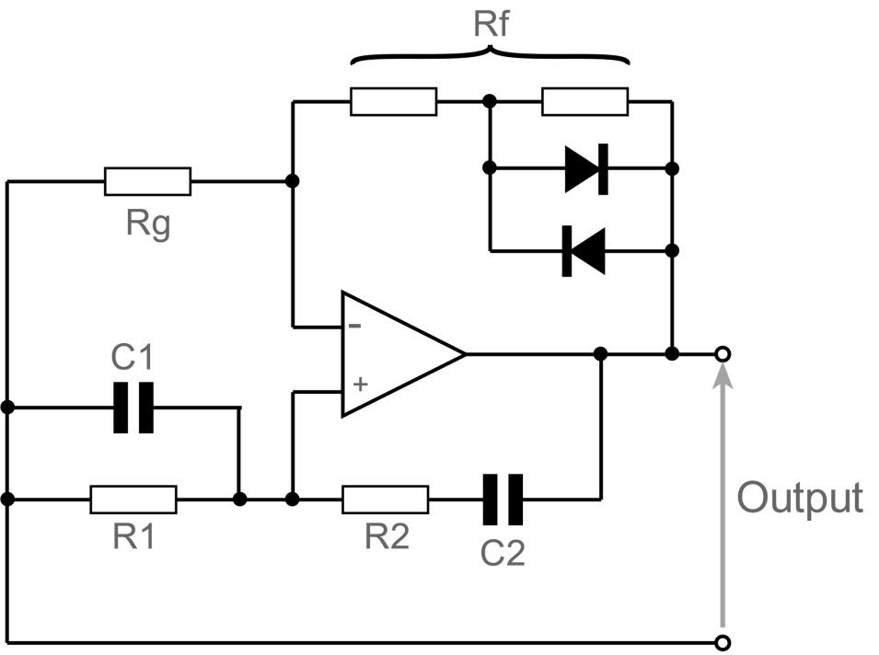
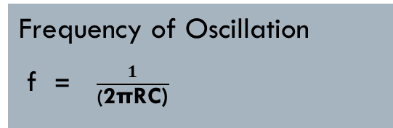
Sine Wave Generation
Wein Bridge Oscillator circuit
A positive gain amplifier combined with a bandpass filter
It is necessary to be able to limit the gain
C1 = C2 and R1 = R2( Rf is typically set to be 2 Rg )
A pair of back to back diodes in the oscillator feedback loop is used to reduce the distortion
At the resonant frequency, the reactance of the overall circuit equals its resistance, Xc = R, and the phase difference between the input and output is zero
Frequency of Oscillation
f = $\frac{1}{\text{(}\text{2}\text{πRC}\text{)}}$

Slide 6
Calculations
Output voltage gain of non-inverting amplifier (Av) =1+ 𝑅1/𝑅2= 𝑉𝑜𝑢𝑡/𝑉𝑖𝑛
To get the oscillation output, Av ≥ 3
For 20kHz C1,C2 = 1nF, R1=R2=8kΩ
For 20Hz C1,C2= 1uF
Assume Rg as 5kΩ , 1+𝑅3/5𝑘Ω ≥3
𝑅3≥10kΩ

Slide 7
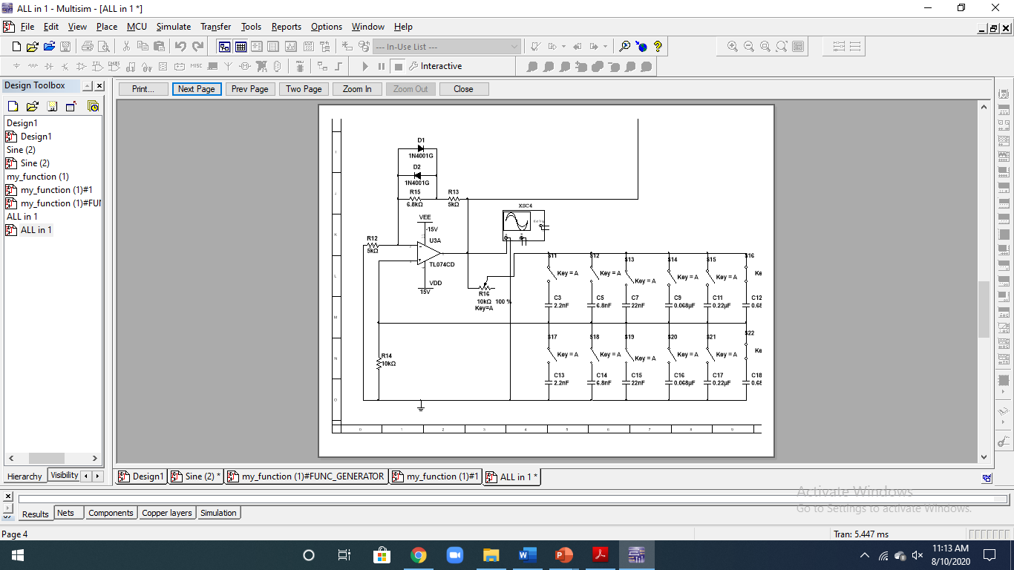

Slide 8
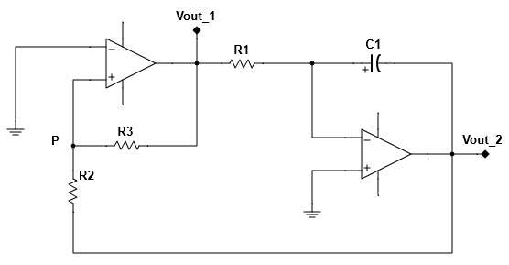
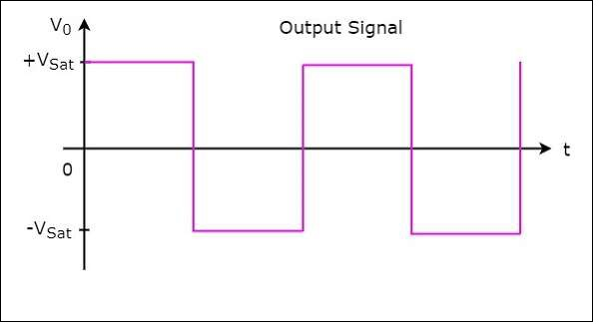
Square wave generation
V1 = Inverting terminal Voltage
VP = Non-inverting terminal Voltage
Vid =VP – V1
If VP > 0 Vid > 0 VOUT_1 = +Vsat
If VP <0 Vid > 0 VOUT_1 = -Vsat

Slide 9

When VOUT_1 >0, VOUT_1= +Vsat,
VOUT_2 = -Vramp
So that at a certain point Vp becomes 0.
When VOUT_1 <0, VOUT_1= -Vsat,
VOUT_2 = +Vramp
F = $\frac{R3}{4×R1×R2×C1}$
Frequency is changed by using R1 potentiometer and set of capacitors for C1

Slide 10
CALCULATIONS
For 20Hz,
R3 = 6.2kΩ, R2 = 2.4kΩ,
R4 = 1kΩ,R5 = 12kΩ
20 = 121×14×(6200+2400)×C1
C1 = 17.44 μF
For 20kHz,
R3 = 0kΩ, R2 = 2.4kΩ,
R4 = 1kΩ, R5 = 12kΩ
20000 = 121×14×(2400)×C1
C1 = 0.0625 μF

Slide 11
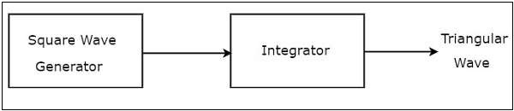
Triangular wave generation
The output of square wave generator circuit is applied as the input of integrator.
Frequency can be changed in the same way as the in square wave generator.

Slide 12
Sawtooth WAVE GENERATION
Sawtooth waveform is generated by modifying the triangular wave generation circuit.
The non-inverting output of the op-amp is set to a potentiometer.
When the voltage of potentiometer decreases – rise time> fall time increases – rise time< fall time

Slide 13
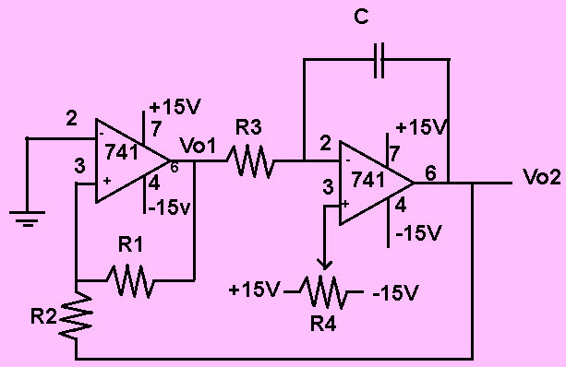
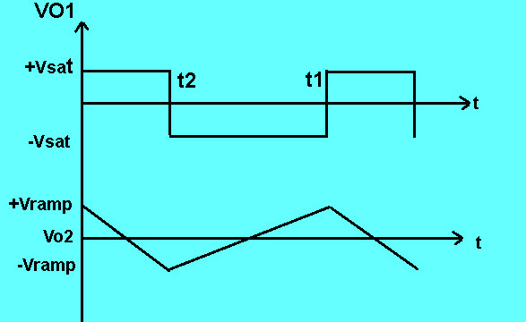

Slide 14
PWM wave generation
Carrier based generation is done
Sawtooth waveform act as the carrier waveform
If the reference signal (sawtooth) voltage is more than the modulating signal voltage, the resultant PWM signal voltage is high (+Vs). Otherwise the resultant PWM signal voltage is low(-Vs).

Slide 15
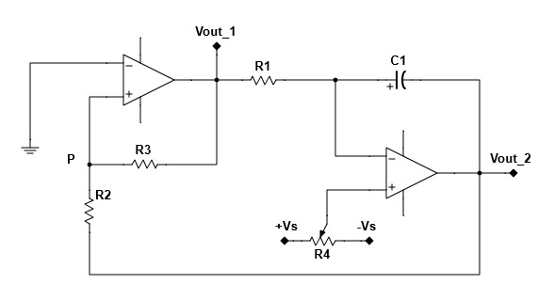
Duty cycle of PWM is varied by using a potentiometer.

Slide 16
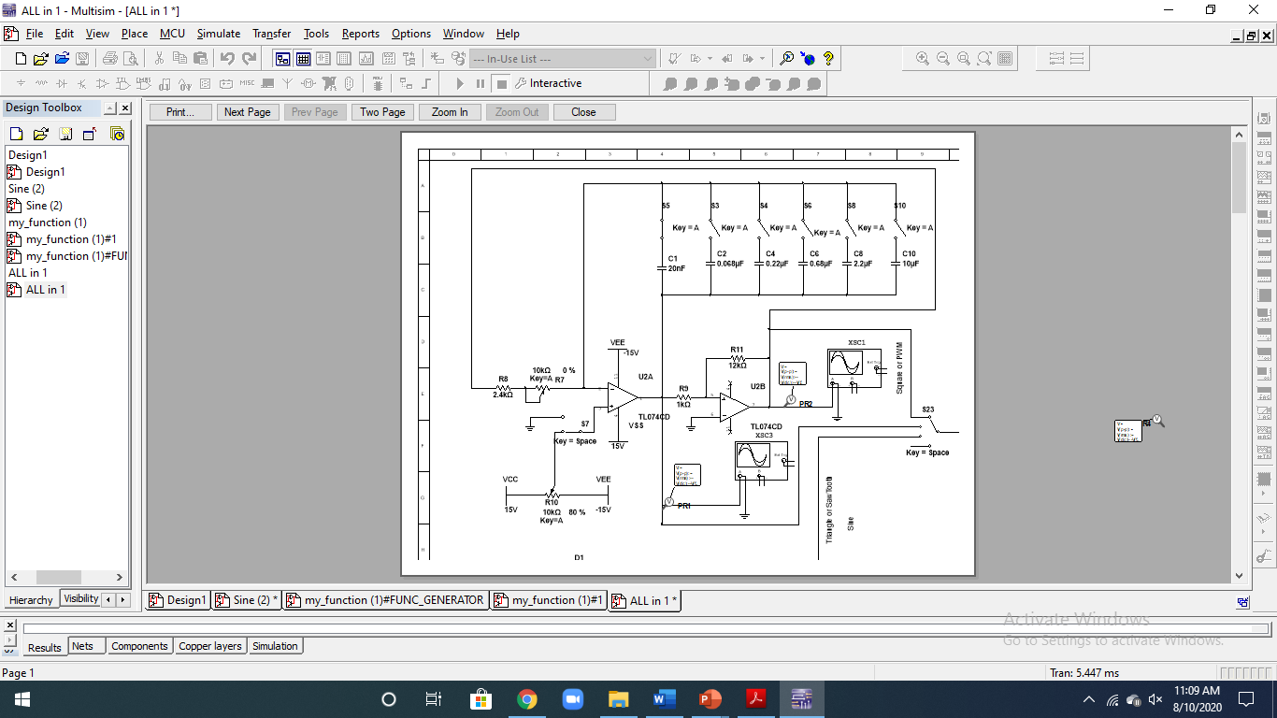

Slide 17
DC SHIFT
It is an inverting amplifier circuit.
Input and a DC voltage is given to the inverting pin of the Op-Amp.
DC voltage is controlled by the potentiometer.

Slide 18
AMPLIFIER CIRCUIT
This circuit is designed in three stages
Inverting Amplifier Stage - To obtain a variable amplitude using potentiometers
Voltage buffer stage - To maintain the stability
Push pull amplifier stage – To produce high current ,Class B type is used

Slide 19
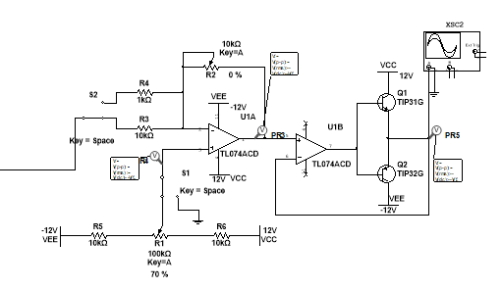

Slide 20
POWER SUPPLY CIRCUIT
+15V and -15V DC power supply
A step-down transformer of 18V, a rectifier bridge and LM7815 and LM7915 regulators are used for this circuit.

Slide 21
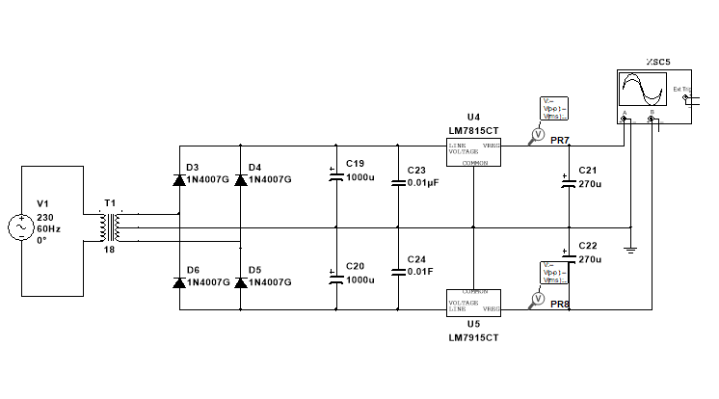

Slide 22
SIMULATION Results

Slide 23
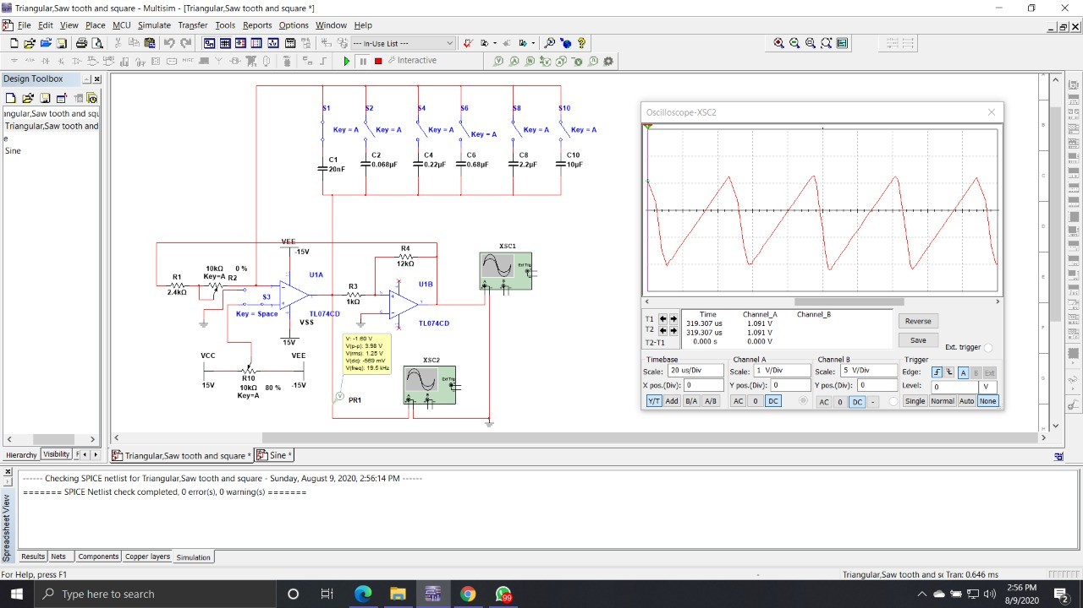

Slide 24
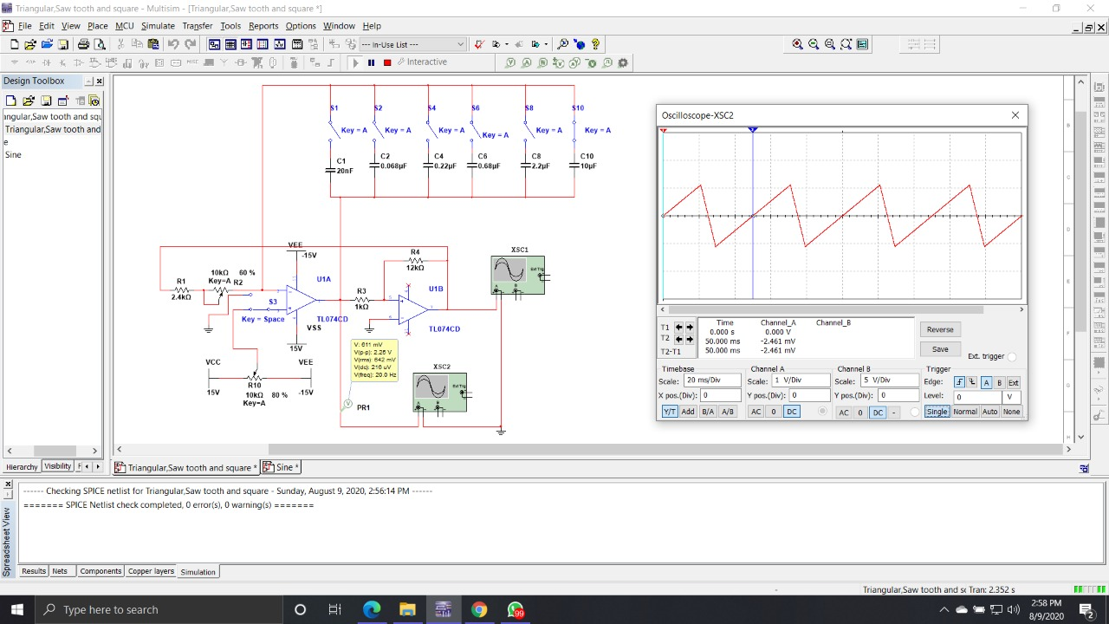

Slide 25
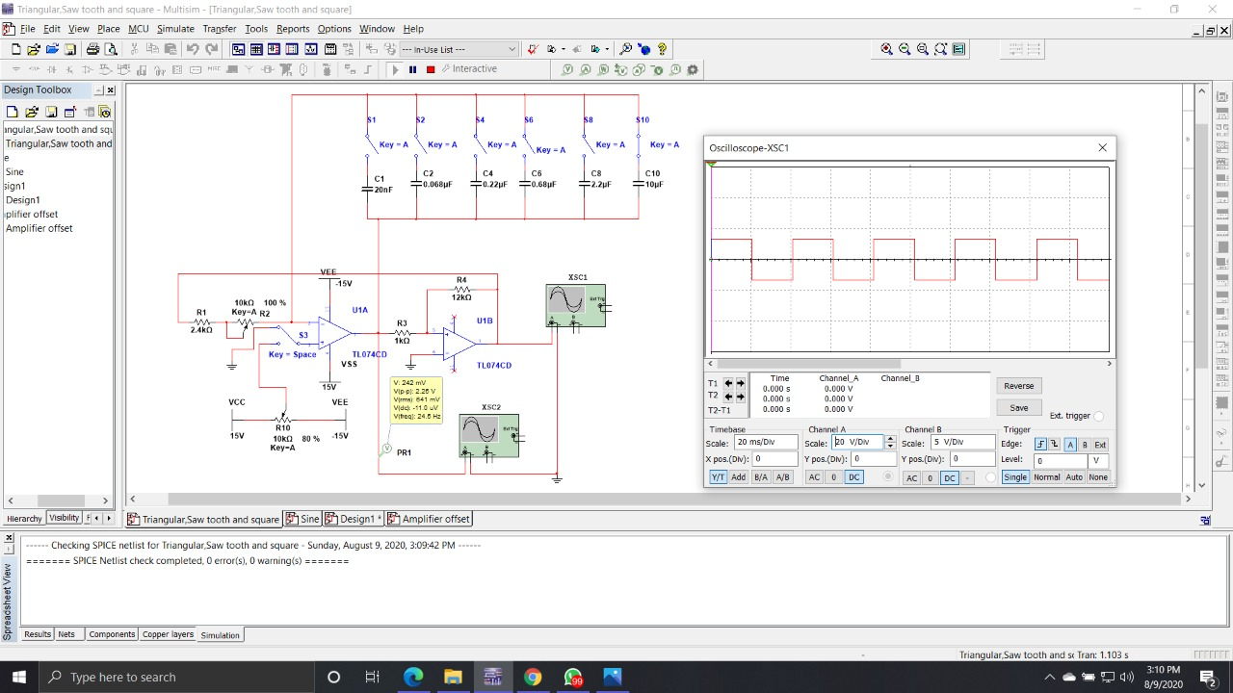

Slide 26
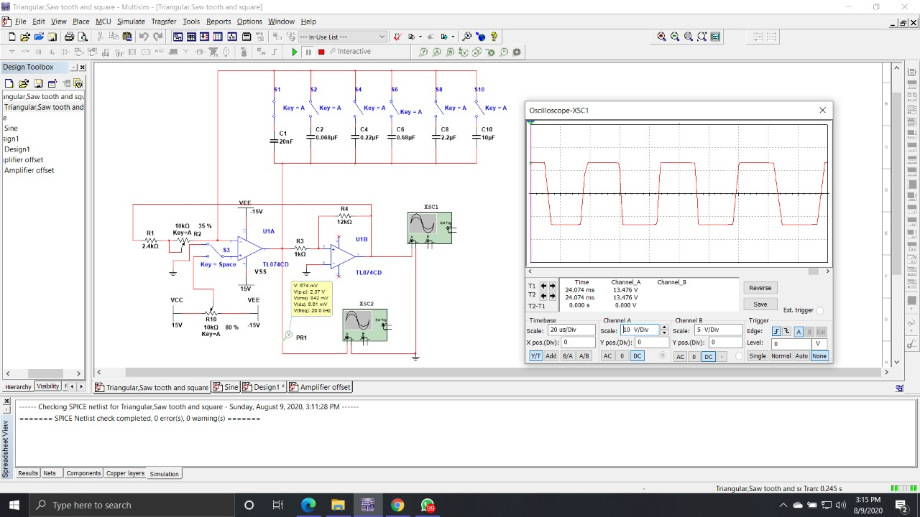

Slide 27
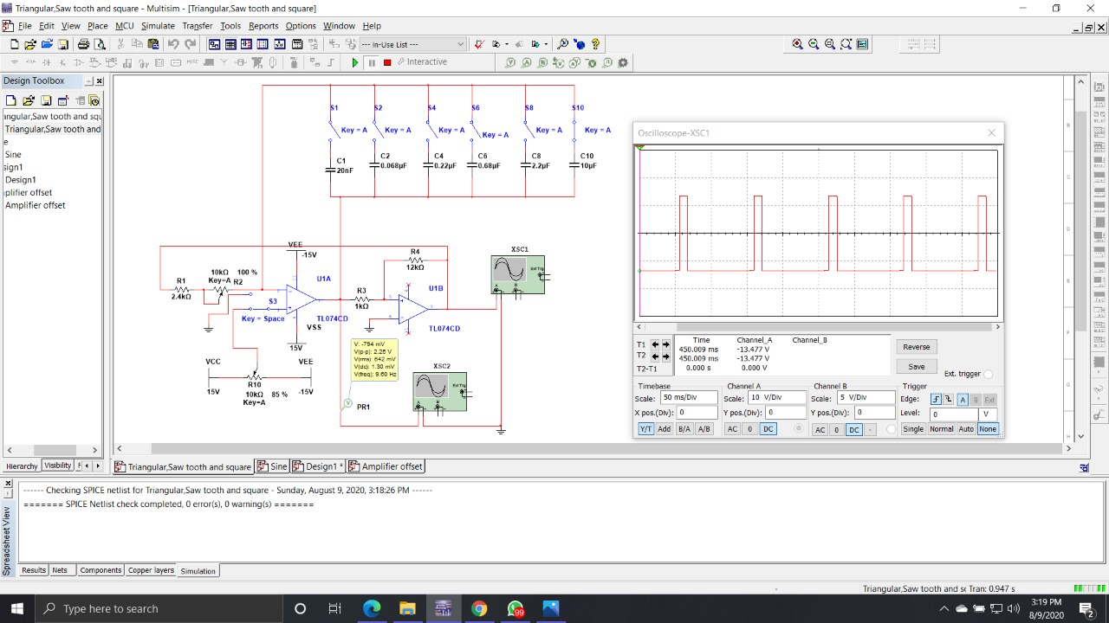

Slide 28
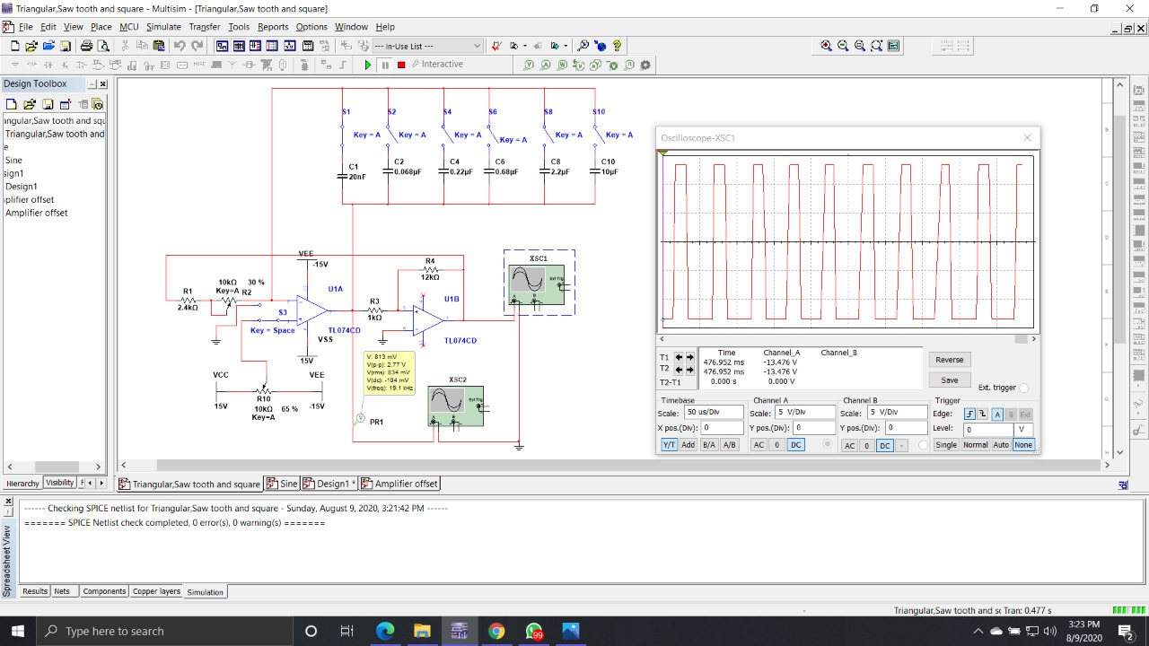

Slide 29
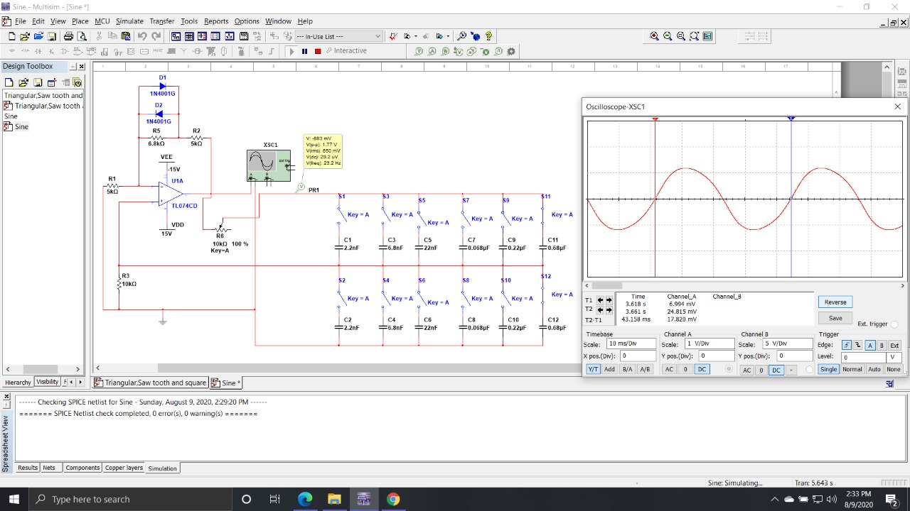

Slide 30
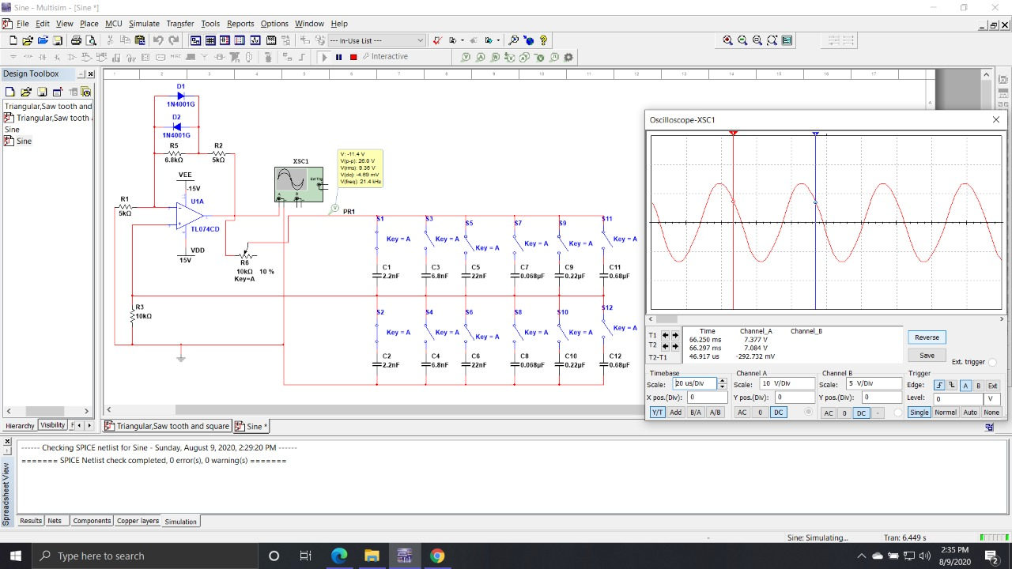

Slide 31
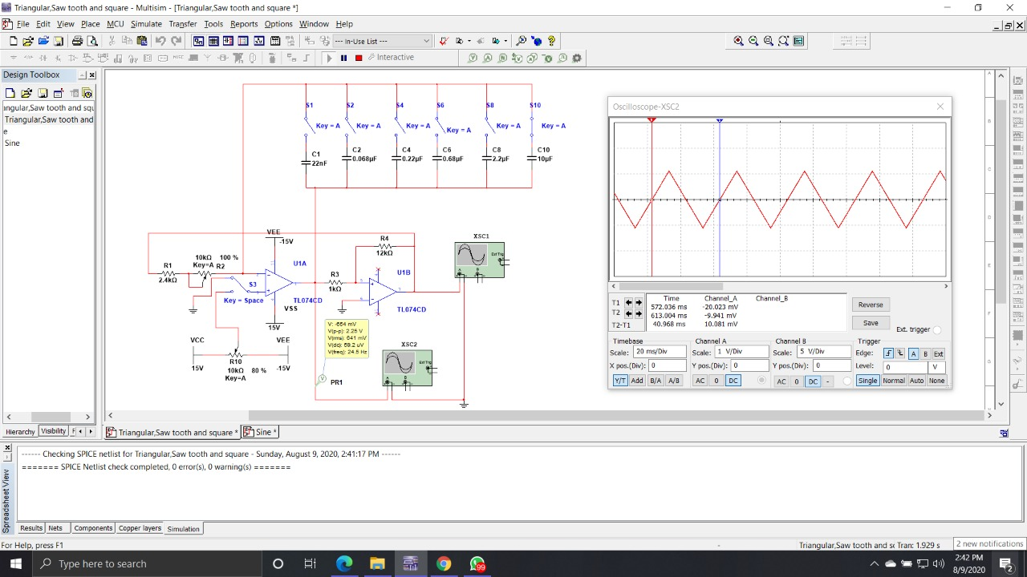

Slide 32
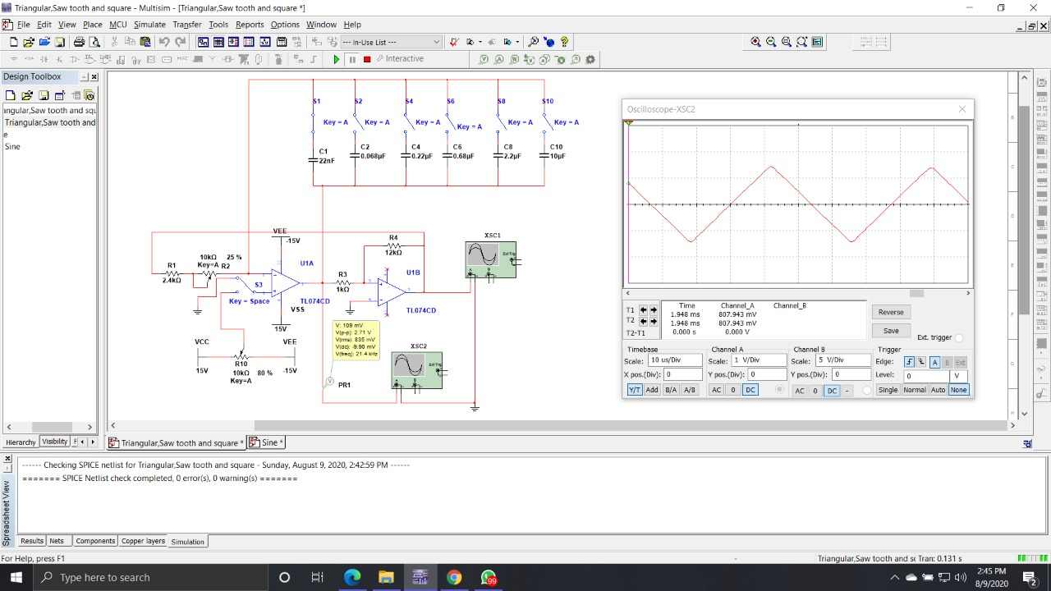

Slide 33
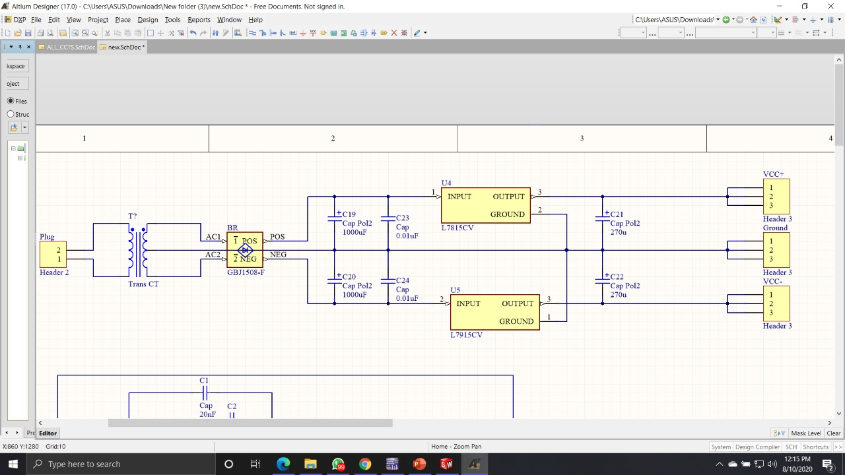
Schematics

Slide 34
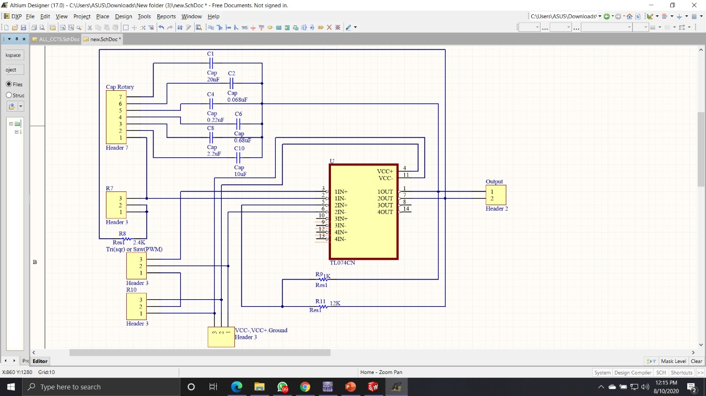

Slide 35
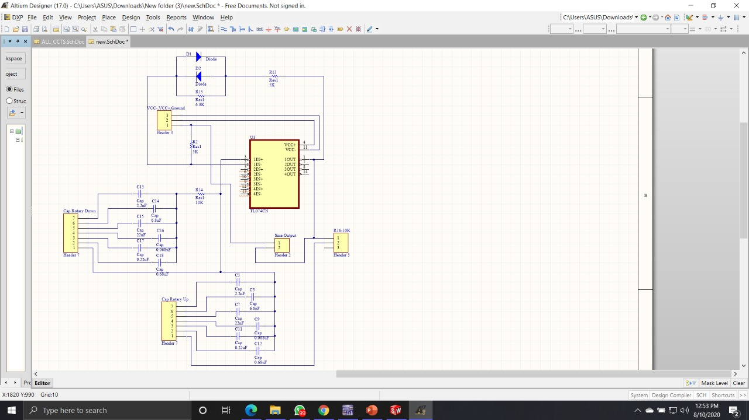

Slide 36
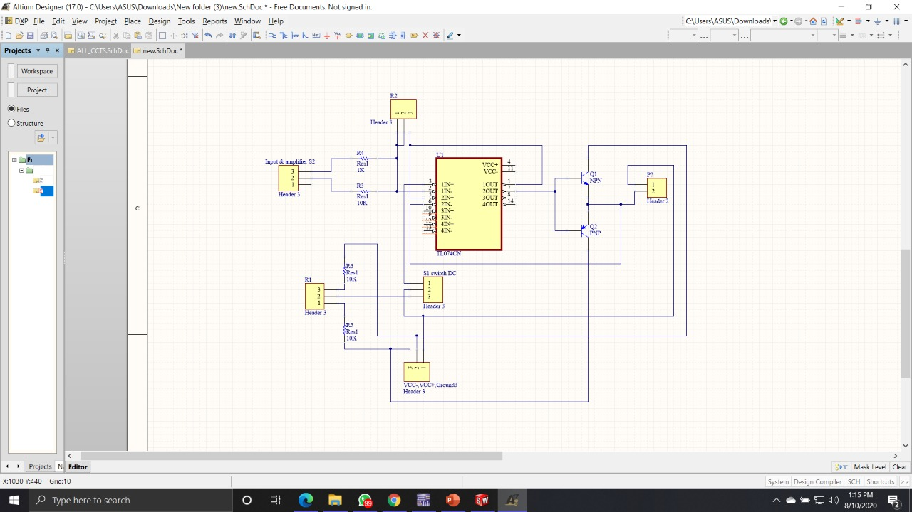

Slide 37
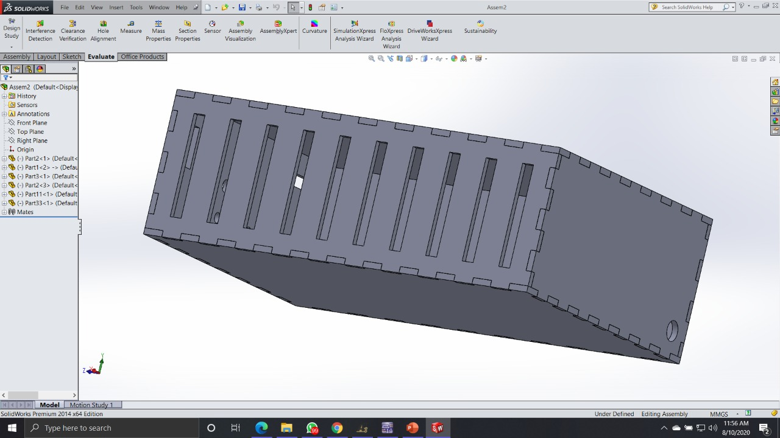
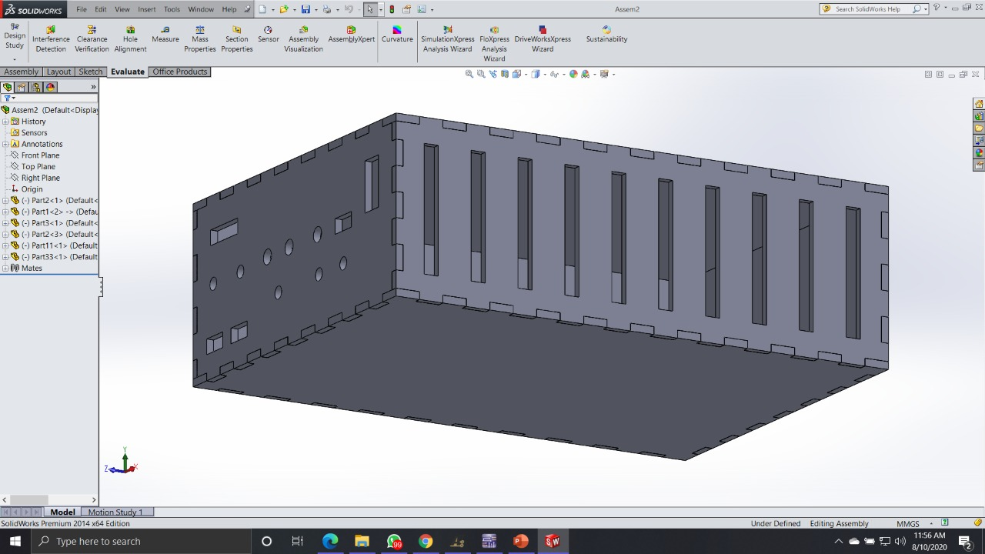
enclosure

Slide 38
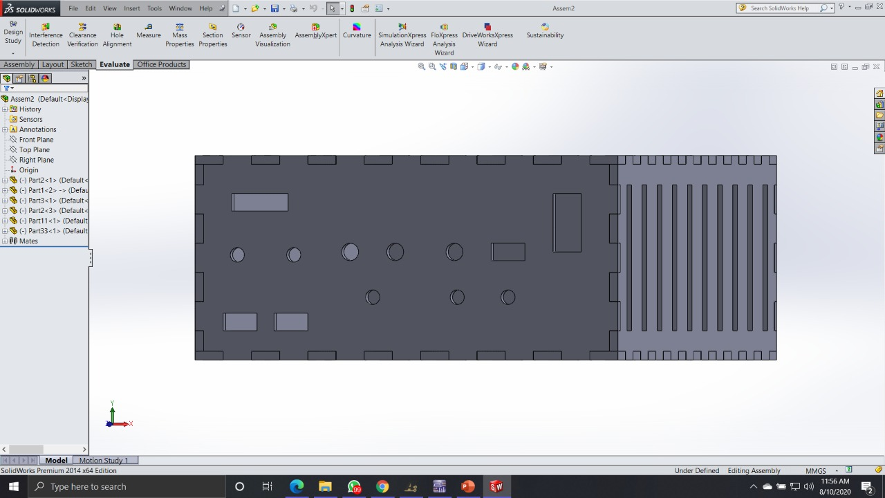
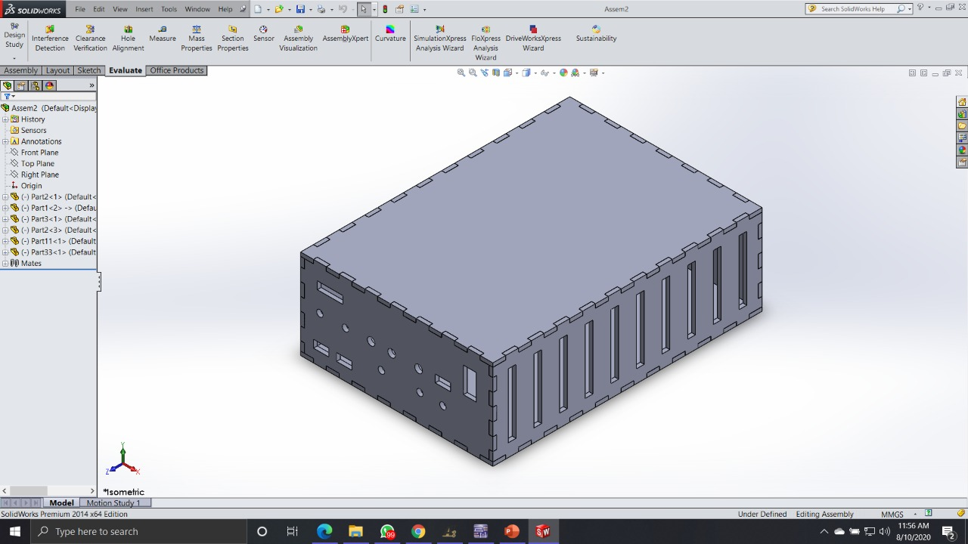

Slide 39
Thank you

